Slide 1
BITS Pilani presentation
Mridul Moitra
Cloud Computing

Slide 2
<CSI ZG527 / SS ZG527 / SE ZG527
Cloud Computing
Lecture No. 1

Slide 3
Introduction to Cloud Computing, services and deployment models
Agenda
Introduction to Cloud Computing – Origins and Evolution
Characteristics of cloud platform
Types of Clouds and Services
Cloud Delivery Model

Slide 4
Motivation
Powerful multi-core processors
General purpose graphic processors
Superior software methodologies
Virtualization leveraging the powerful hardware
Wider bandwidth for communication
Proliferation of devices
Explosion of domain applications
Web Scale Problems
Web 2.0 and Social Networking
Information Explosion
Mobile Web
Notes:
RL 1.1

Slide 5

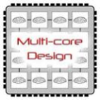
Technology Advances
Cloud applications: data-intensive, compute-intensive, storage-intensive
Bandwidth
WS
Services interface
Web-services, SOA, WS standards
VM0
VM1
VMn
Storage Models: S3, BigTable, BlobStore, ...
Virtualization: bare metal, hypervisor. …
Multi-core architectures
64-bit processor

Slide 6
Evolution of cloud computing?
The evolution of cloud computing can be bifurcated into three basic phases:
1. The Idea Phase- This phase incepted in the early 1960s with the emergence of utility and grid computing and lasted till pre-internet bubble era. Joseph Carl Robnett Licklider was the founder of cloud computing.
2. The Pre-cloud Phase- The pre-cloud phase originated in 1999 and extended to 2006. In this phase the internet as the mechanism to provide Application as Service.
3. The Cloud Phase- The much talked about real cloud phase started in the year 2007 when the classification of IaaS, PaaS, and SaaS got formalized. The history of cloud computing has witnessed some very interesting breakthroughs launched by some of the leading computer/web organizations of the world.

Slide 7
What is Cloud Computing?
Cloud Computing is a general term used to describe a new class of network based computing that takes place over the Internet,
basically a step on from Utility Computing
a collection/group of integrated and networked hardware, software and Internet infrastructure (called a platform).
Using the Internet for communication and transport provides hardware, software and networking services to clients
These platforms hide the complexity and details of the underlying infrastructure from users and applications by providing very simple graphical interface or API (Applications Programming Interface).

Slide 8
What is Cloud Computing cont.…
the platform provides
on-demand services, that are always on, anywhere, anytime and any place.
Pay for use and as needed, elastic
scale up and down in capacity and functionalities
The hardware and software services are available to
The hardware and software services are available to
general public, enterprises, corporations and businesses markets

Slide 9
Cloud Computing: Definition
The US National Institute of Standards (NIST) defines cloud computing as follows:
Cloud computing is a model for enabling ubiquitous, convenient, on-demand network access to a shared pool of configurable computing resources (e.g., networks, servers, storage, applications, and services) that can be rapidly provisioned and released with minimal management effort or service provider interaction.
Notes:
RL 1.2

Slide 10
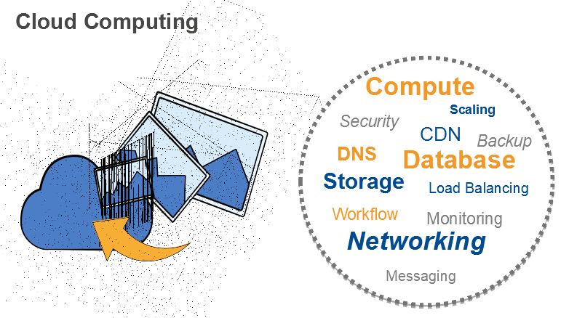
Cloud Computing

Slide 11
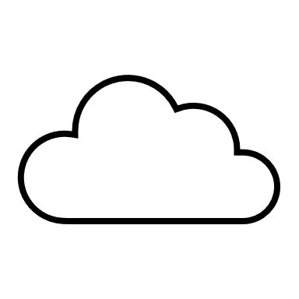
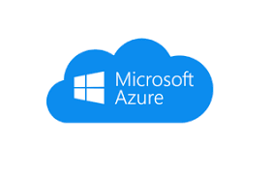
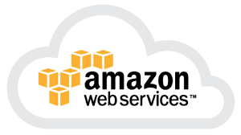
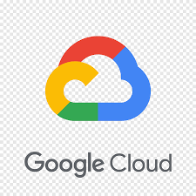
Cloud Transformation Journey
Legacy Data Centre
Static
Modern Data Centre
Dynamic
On-Prem Private Cloud
CSP Hosted
Private Cloud
Dedicated IT Infrastructure
System of Records
System of Engagement
AI
Prod A
Prod A
Front End
Prod B
Prod B
Public Cloud
On-Premise
Back End
Dev Env
Cloud Integration
Cloud Aggregation
Cloud Diversification
Single Application
High Availability and Global Reach
Avoid vendor-Lock-in
Minimize Switching cost

Slide 12

Challenges Of the CIO
Globalisation
New markets
Leveraging low-cost regions
Expanding into new geographies
Macro economics
Global economic slowdown:
Global economic pressure
Reduced corporate profits
Reduced IT budgets
New models
Consumerisation & cloud:
New GTM models
New buying patterns
Shift of control
IT a platform for business
Increasing demand for IT services:
Business models & GTM
Business units
New offerings
New channels
Complexity
Technology disruption:
Pace & scope of change
Ageing assets
Cost & shortage of skills
Compliancy
Competitive landscape
Time-to-market:
New age competitors
Global competitors
Cost-to-market

Slide 13
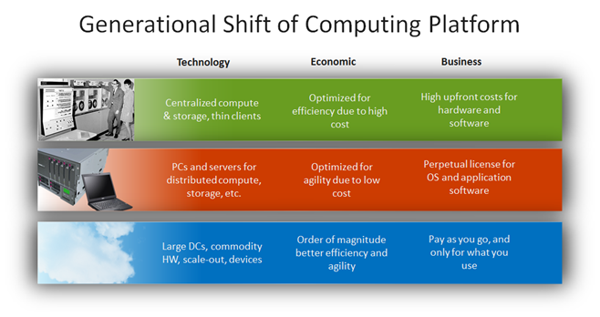
Drivers for the new Platform
http://blogs.technet.com/b/yungchou/archive/2011/03/03/chou-s-theories-of-cloud-computing-the-5-3-2-principle.aspx

Slide 14
Cloud Computing Business Drivers
No capex, less assets
Pay-as-you-use
On-demand capacity
Elasticity
Economies of scale
Time-to-value
Cost optimisation
Business continuity
Technology independence
Operational complexity
Specialised skills
Time-to-market
Innovation
New business models
Resource leverage
Adaptability
Flexibility
Risk optimisation
Strategic agility
...why would one not consider these benefits?

Slide 15
3-4-5 rule of Cloud Computing
NIST specifies 3-4-5 rule of Cloud Computing
3 cloud service models or service types for any cloud platform
4 deployment models
5 essential characteristics of cloud computing infrastructure

Slide 16
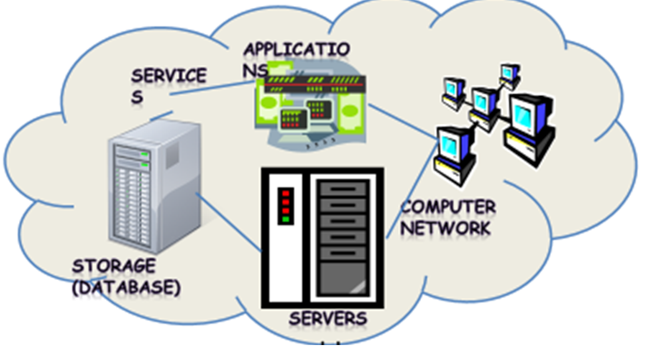
Cloud Summary
Shared pool of configurable computing resources
On-demand network access
Provisioned by the Service Provider

Slide 17
Cloud Summary…
Cloud computing is an umbrella term used to refer to Internet based development and services
A number of characteristics define cloud data, applications services and infrastructure:
Remotely hosted: Services or data are hosted on remote infrastructure.
Ubiquitous: Services or data are available from anywhere.
Commodity model: The result is a utility computing model similar to traditional that of traditional utilities, like gas and electricity - you pay for what you would want!

Slide 18
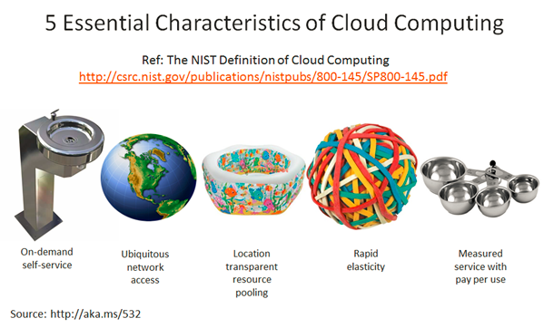
Characteristics of Cloud Computing
On demand self-service
Broad network access
Resource pooling
Rapid elasticity
Measured service

Slide 19
Characteristics of Cloud Computing
Essential Characteristics
On-demand self-service
Broad network access
Resource pooling
Rapid elasticity
Measured service
Service Models
Software as a Service
Platform as a Service
Infrastructure as a Service
Deployment Models
Private
Public
Hybrid
Community

Slide 20

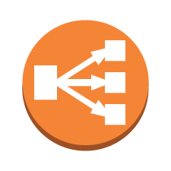

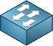
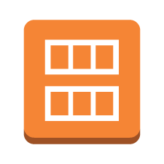

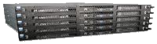

AWS Core Infrastructure & Services
Traditional Infrastructure Amazon Web Services
Security
Security
Security
AWS Technical Essentials 3.6 ILT
Security Groups
NACLs
Access Mgmt
Security Groups
NACLs
Access Mgmt
Network
Networking
“Public”
Network
“Public”
EC2 “Classic”
ELB
VPC
Provision
EC2 “Classic”
Servers
VPC
On-Demand
ELB
VPC
Servers
AMI
Amazon EC2
Instances
RDBMS
Storage & Database
DAS
SAN
NAS
Glacier
EBS
S3
RDS

Slide 21
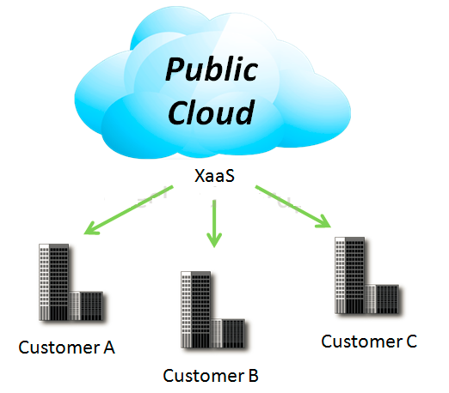
4 Deployment Models
1. Public Cloud
Mega-scale cloud infrastructure is made available to the general public or a large industry group and is owned by an organization selling cloud services.
Notes:
XaaS is Anything as a service
[http://www.definethecloud.net/cloud-types/]

Slide 22
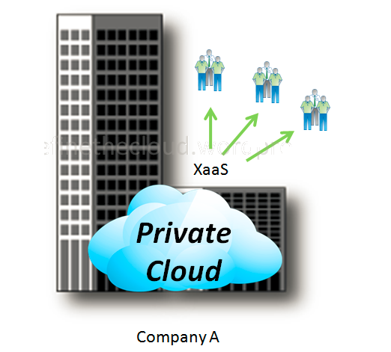
4 Deployment Models
2. Private Cloud
The cloud infrastructure is operated solely for an organization. It may be managed by the organization or a third party and may exist on premise or off premise.

Slide 23
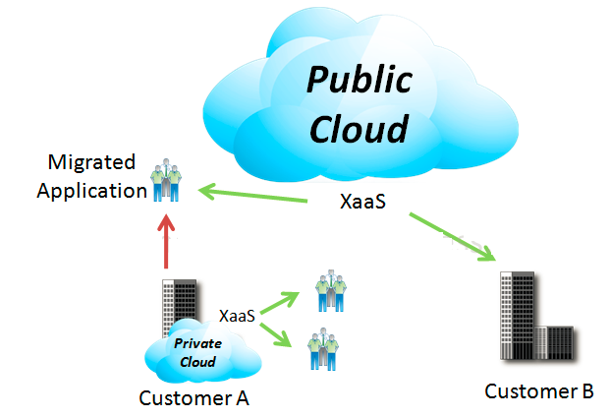
4 Deployment Models
3. Hybrid Cloud
The cloud infrastructure is a composition of two or more clouds (private or public) that remain unique entities but are bound together by standardized or proprietary technology that enables data and application portability

Slide 24
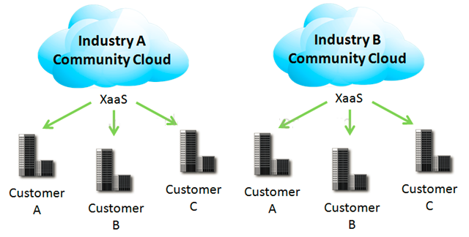
4 Deployment Models
4. Community Cloud
Community Clouds are when an ‘infrastructure is shared by several organizations and supports a specific community that has shared concerns (e.g., mission, security requirements, policy, and compliance considerations). It may be managed by the organizations or a third party and may exist on premise or off premise’ according to NIST.
A community cloud is a cloud service shared between multiple organizations with a common tie/goal/objective.
E.g. OpenCirrus

Slide 25
Introduction to Cloud Computing, services and deployment models
Agenda
Introduction to Cloud Computing – Origins and Motivation
3-4-5 rule of Cloud Computing
Types of Clouds and Services
Cloud Infrastructure and Deployment

Slide 26
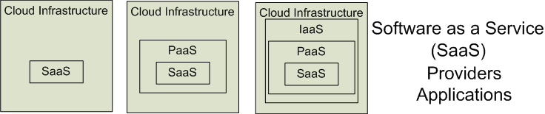

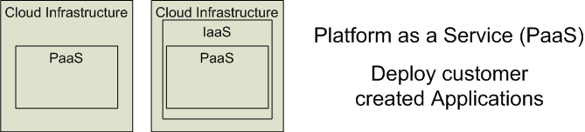
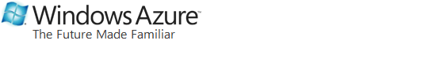
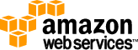
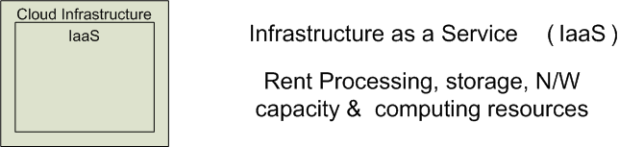

3 Cloud Service Models
Software as a Service (SaaS)
Platform as a Service (PaaS)
Infrastructure as a Service (IaaS)
SalesForce CRM
LotusLive
Google App Engine
Notes:
RL 1.3

Slide 27
Software as a Service (SaaS)
Software as a service features a complete application
offered as a service on demand.
A single instance of the software runs on the cloud
and services multiple end users or client organizations.
E.g. salesforce.com , Google Apps

Slide 28
Platform as a Service
Platform as a service encapsulates a layer of software and provides it as a service that can be used to build higher-level services.
2 Perspectives for PaaS :-
1. Producer:- Someone producing PaaS might produce a platform by integrating an OS, middleware, application software, and even a development environment that is then provided to a customer as a service.
2. Consumer:-Someone using PaaS would see an encapsulated service that is presented to them through an API. The customer interacts with the platform through the API, and the platform does what is necessary to manage and scale itself to provide a given level of service. Virtual appliances can be classified as instances of PaaS.

Slide 29
Infrastructure as a Service
Infrastructure as a service delivers basic storage and computing capabilities as standardized services over the network.
Servers, storage systems, switches, routers , and other systems are pooled and made available to handle workloads that range from application components to high-performance computing applications.

Slide 30
Service Models Summary
Cloud Software as a Service (SaaS)
The capability provided to the consumer is to use the provider’s applications running on a cloud infrastructure and accessible from various client devices through a thin client interface such as a Web browser (e.g., web-based email). The consumer does not manage or control the underlying cloud infrastructure, network, servers, operating systems, storage, or even individual application capabilities, with the possible exception of limited user-specific application configuration settings.
Cloud Platform as a Service (PaaS)
The capability provided to the consumer is to deploy onto the cloud infrastructure consumer-created applications using programming languages and tools supported by the provider (e.g., Java, Python, .Net). The consumer does not manage or control the underlying cloud infrastructure, network, servers, operating systems, or storage, but the consumer has control over the deployed applications and possibly application hosting environment configurations.
Cloud Infrastructure as a Service (IaaS)
The capability provided to the consumer is to rent processing, storage, networks, and other fundamental computing resources where the consumer is able to deploy and run arbitrary software, which can include operating systems and applications. The consumer does not manage or control the underlying cloud infrastructure but has control over operating systems, storage, deployed applications, and possibly select networking components (e.g., firewalls, load balancers).
.

Slide 31
Cloud Infrastructures
Key Technology is Virtualization
App
App
App
App
App
App
OS
OS
OS
Operating System
Hypervisor
Hardware
Hardware
Traditional Stack
Virtualized Stack
Virtualization plays an important role as an enabling technology for datacentre implementation by abstracting compute, network, and storage service platforms from the underlying physical hardware
Notes:
Virtualization is simulating a hardware platform, operating system, storage device or network resources

Slide 32
Cloud Providers Characteristics
Provide on-demand provisioning of computational resources
Use virtualization technologies to lease these resources
Provide public and simple remote interfaces to manage those resources
Use a pay-as-you-go cost model, typically charging by the hour
Operate data centers large enough to provide a seemingly unlimited amount of resources to their clients

Slide 33
Management of Virtualized Resources
Distributed Management of Virtual Machines
Reservation-Based Provisioning of Virtualized Resources
Provisioning to Meet SLA Commitments
Notes:
Distributed Management of Virtual Machines
Managing VMs need to set up custom software environments for VMs, setting up and managing networking for interrelated VMs, and reducing the various overheads involved in using VMs. Thus, VI managers must be able to efficiently orchestrate all these different tasks.
Reservation-Based Provisioning of Virtualized Resources
Determination of the demand for resources is known beforehand so that the computational resources must be available at exactly that time to process the data produced by the equipment
Provisioning to Meet SLA Commitments
IaaS clouds can be used to deploy services that will be consumed by users other than the one that deployed the services. cloud providers are typically not directly exposed to the service semantics or the SLAs that service owners may contract with their end users. The capacity requirements are, thus, less predictable and more elastic.

Slide 34
Cloud Infrastructure Anatomy
The key component of an IaaS cloud architecture is the cloud OS, which manages the physical and virtual infrastructures and controls the provisioning of virtual resources according to the needs of the user services
A cloud OS’s role is to efficiently manage datacenter resources to deliver a flexible, secure, and isolated multitenant execution environment for user services that abstracts the underlying physical infrastructure and offers different interfaces and APIs for interacting with the cloud
While local users and administrators can interact with the cloud using local interfaces and administrative tools that offer rich functionality for managing, controlling, and monitoring the virtual and physical infrastructure, remote cloud users employ public cloud interfaces that usually provide more limited functionality

Slide 35
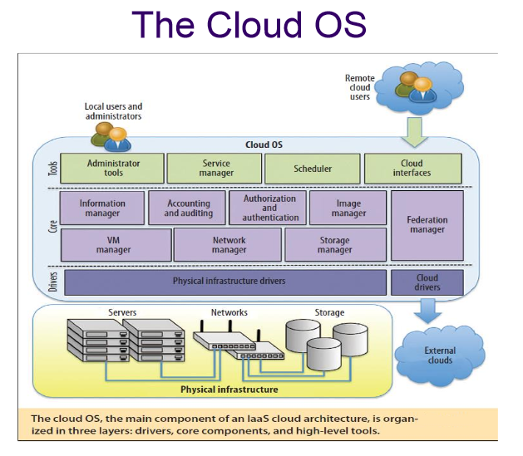
The cloud operating system is responsible for:
1. managing the physical and virtual infrastructure,
2. orchestrating and commanding service provisioning and deployment
3. providing federation capabilities for accessing and deploying virtual resources in remote cloud infrastructures

Slide 36
Pros and Cons of Cloud Computing
Why is it becoming a Big Deal:
Using high-scale/low-cost providers,
Any time/place access via web browser,
Rapid scalability; incremental cost and load sharing,
Can forget need to focus on local IT.
Concerns:
Performance, reliability, and SLAs,
Control of data, and service parameters,
Application features and choices,
Interaction between Cloud providers,
No standard API – mix of SOAP and REST!
Privacy, security, compliance, trust…

Slide 37
Public Cloud
Implementation of cloud services on resources that are shared between many customers, managed off-premises
Typically, cloud provider owns and controls the resources/assets, definition of services, costs and risks
Variations exist – such as hosters and integrated cloud platforms
Cloud solutions
Office 365 (SaaS)
Dynamics CRM Online (SaaS)
Windows Azure platform (PaaS)
EC2, RDS

Slide 38
Private Cloud
Implementation of cloud services on resources that are dedicated to your organization, whether they exist on-premises or off-premises
Typically, your organization owns and controls the resources/assets, definition of services, costs and risks
Variations exist – such as hosted and virtual private clouds
Cloud solutions
Windows Server 2008 R2 Hyper-V, System Center (IaaS)
Windows Azure Appliance (PaaS)
Database Services

Slide 39
Private Cloud
Private clouds are cloud infrastructures that are deployed for a single organization.
These can be managed internally or externally, but all systems and infrastructure are for the purposes of the organization.
When considering a private cloud, the biggest
decision that a business needs to make is the scope of the needed investment to create the private cloud, as implementation can be very expensive.

Slide 40

Private Cloud vs. Public Cloud
More than a location and ownership distinction
Private Cloud
Control
Conventional storage
Custom policies
Heterogeneous infrastructure
Regulatory compliance & data sovereignty
Public Cloud
Scale
Cloud storage
Common policies
Homogeneous infrastructure
Work in progress

Slide 41
Hybrid Cloud
Mixed/blended model of private and public clouds
Variations and multiple interpretations exist
On-premises and off-premises bridging
Most common scenario today
Especially for large enterprises
More than a deployment / delivery model
Application design, architectural model

Slide 42
Product Families and Cost Principles
Lower Cost
Higher Cost
Cost of Service
More Shared Elements
Level of Sharing
Less Shared Elements
Public Compute Services
Hosted Private Compute Services
Private Compute Services

Slide 43
Cloud Service Models
Traditional IT
Infrastructure
(as a Service)
Platform
(as a Service)
Software
(as a Service)
Applications
Applications
You manage
Applications
Applications
Data
You manage
Data
Data
Data
Runtime
Runtime
Runtime
Runtime
Delivered as a service
You manage
Middleware
Middleware
Middleware
Middleware
Delivered as a service
Operating System
Operating System
Operating System
Operating System
Virtualization
Virtualization
Delivered as a service
Virtualization
Virtualization
Servers
Servers
Servers
Servers
Storage
Storage
Storage
Storage
Networking
Networking
Networking
Networking

Slide 44
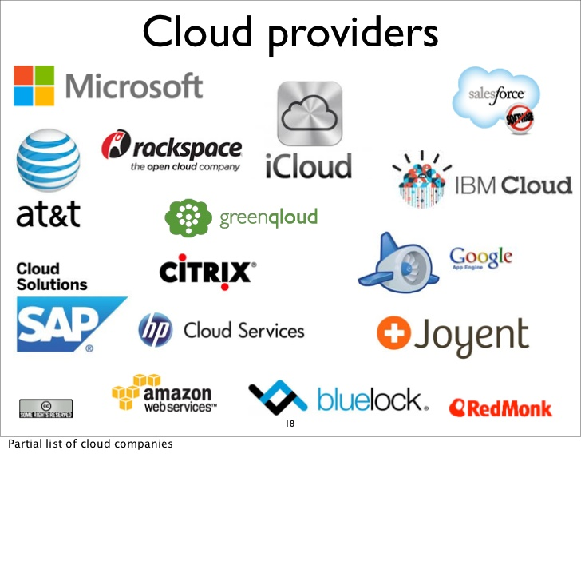
Cloud Provider List

Slide 45
Is public cloud the best option?
Businesses that are best suited for using the public cloud are ones that need to bring a product/service to market quickly without the internal infrastructure and support to build out their own private cloud system. It does provide smaller companies without IT departments the opportunity to match the deployment speed of larger companies.

Slide 46
Pros and Cons of Public Cloud
Increased network efficiency and more resources
Reduced complexity and lead times (because the architecture is fixed)
Ready-to-go applications used within the public cloud can conform to the demands of business
Disadvantages Of Public Cloud:
Fewer options for customization
Substantially less secure
Fixed architecture cannot (at times) grow with the needs of the business

Slide 47
Is the private cloud the best option?
Businesses that are best suited for the private cloud are ones that must comply with
regulatory guidelines or have highly volatile applications needed within the cloud.
Additionally, these businesses will be required to install their own servers and storage
hardware that allows for modifications in workloads. Though this can be a significant
investment, it is required if the business deals with regulated data or must comply with
industry rules.

Slide 48
Pros and Cons of private Cloud
Advantages Of Private Cloud:
Extensive security options and capabilities, substantially more than the public cloud availability to the internal network and increased access/communication for internal users can grow with a business and be expanded or changed as needed
Disadvantages Of Private Cloud:
Significant level of engagement from both management and IT departments are
required
Significant investment is required, both to build the private cloud and maintain/grow it
Does not deliver the short-term solutions – given the required time needed to build it out – that the public cloud does

Slide 49
Pros and Cons of Hybrid Cloud
Advantages Of Hybrid Cloud:
Best of both the public and private cloud in terms of needed resources
Added accessibility for internal and external users
Security parameters are higher than that of the public cloud
Disadvantages Of Hybrid Cloud:
Inherent inefficiency of monitoring several different security platforms
Customization of rules and policies to govern security and the elements of
infrastructure that do not link between the public and private cloud
Added security risk

Slide 50
Is hybrid cloud the best option?
Businesses that are best suited to the hybrid cloud are those with sites that have
unreliable fluctuations in traffic. With e-commerce, these fluctuations vary greatly
between times of day and seasons in the year. Because the hybrid cloud has the same
security of the private cloud, businesses can utilize both the added resources and the
security to facilitate the needs of their customers. In essence, it is the best of both
worlds.

Slide 51
Cloud management system
Addresses the complexity of cloud orchestration, provisioning and billing
CloudControl
Service Delivery Layer
Cloud Platform
CloudControl
Web Console
RESTful API
User controls
Provisioning
Management
Administration
Sign-up
Billing and metering
Permissions
Reporting
Resource management
Service Administration
Pricing
Metering
Accounting
Reporting
User Permissions
Billing
Resource Management
CloudControl™
Servers
CPU
RAM
Storage
Controls
VLAN
Firewall
VPN
Load Balancing
NAT
Multicast
Cloud management system
Orchestration Administration Billing Provisioning Management Support Federation

Slide 52
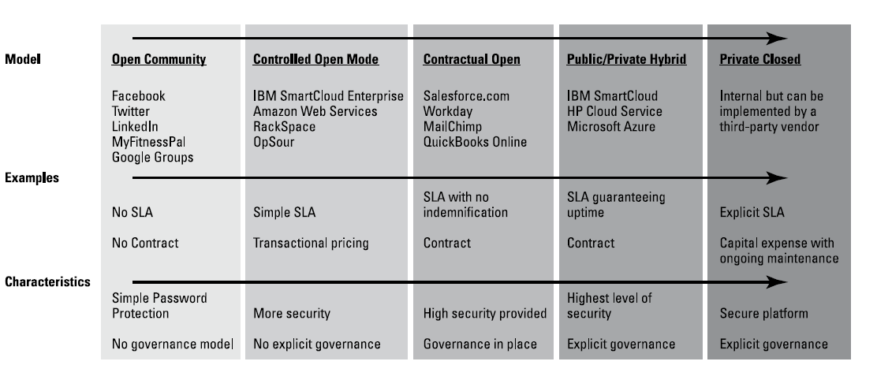
Consumption Model

Slide 53
Use Cases
Elastic/burst capacity (e.g., apps with variable load, HPC / parallel processing, etc.)
Temporal applications (e.g., marketing apps, test & QA environments, etc.)
Cloud-based DMZ / Perimeter Zone
High Performance Compute
Backup and storage
Disaster recovery
These work, but they are still deployment models

Slide 54

Thank You

Slide 55
Topics of Interest as GF
Course No. | Course Title | Course Description
DSE*ZG522 | Big Data Systems | What is big data - are existing systems sufficient?; Data Warehouse v/s Data Lakes; Hadoop – Components; Storage - Relational DBs/ NoSQL dbs / HDFS / HBase / Object Data stores - S3; Serialization; Interfaces - Hive/ Pig; Stream Processing; Spark; Mahout. | Yes
SS ZG527 | Cloud Computing | Concurrency and distributed computing, message passing over the network, connectivity and failure models, local vs remote connectivity, distributed resource modeling, distributed data models; replication & consistency; virtualization; CPU virtualization, memory and storage virtualization, virtualized networks, computing over WAN and Internet; computing on the cloud, computing models, service models and service contracts, programming on the cloud; Cloud infrastructure, LAN vs Wan issue, resource scaling and resource provisions, performance models, scalability, performance measurement and enhancement techniques; cloud applications and infrastructure services. | Yes
IS ZC446 | Data Storage Technologies & Networks | Storage Media and Technologies – Magnetic, Optical and Semiconductor media, techniques for read/write operations, issues and limitations. Usage and Access – Positioning in the memory hierarchy, Hardware and Software Design for access, Performance issues. Large Storages – Hard Disks, Networked Attached Storage, Scalability issues, Networking issues. Storage Architecture. - Storage Partitioning, Storage System Design, Caching, Legacy Systems. Storage Area Networks – Hardware and Software Components, Storage Clusters/Grids. Storage QoS – Performance, Reliability, and Security issues. | Yes
SS ZG515/DSE*ZG515 | Data Warehousing | Introduction, evolution of data warehousing; decision support systems; goals, benefit, and challenges of data warehousing; architecture; data warehouse information flows; software and hardware requirements; approaches to data warehouse design; creating and maintaining a data warehouse; Online Analytical Processing (OLAP) and multi-dimensional data, multi-dimensional modeling; view materialization; data marts; data warehouse metadata; data mining. | Yes
CSI** ZG522 | Design and Operation of Data Centers | Data Center Design: Principles (Scalability, Reliability, and Elasticity), Components - Computing Infrastructure (Processing, Storage, and Networking) and Physical Infrastructure (Power, Cooling, and Physical Security); Servers – Server Hardening, Server Optimization, Server Deployment and Consolidation, Converged and Hyper-Converged Infrastructure. Application monitoring and maintenance. Networking for data centers – device hardening, bandwidth aggregation, traffic management, redundancy, network isolation, deployment of internal security and peripheral security; Contingency Planning & Disaster Recovery: Backup, recovery, and redundancy/replication technologies and approaches. Data Center Architecture: Private, Public, and Hybrid models; Distributed Data Centers; Introduction to Software Defined DataCenters. Costing and Pricing– Costing and Cost Optimization, Pricing and Economics of Data Center Operation. | Yes
 | Ethics for Data Science | Introduction to data ethics, perils of big data, foundations of data privacy, challenges of privacy in the digital age, data policies, consent and fair usage. | Yes
 | Infrastructure Management | Introduction to System Management IT Infrastructure, Introduction to System Management IT Infrastructure, Staffing Legislation , Ethics, Outsourcing for ITSM, Customer Service, Availability, 6. Performance and Tuning, Production Acceptance, Change Management,Problem Management, Storage Management, Network Management, Configuration Management, Capacity Planning, Strategic Security, Business Continuity, Facilities Management, Developing Robust Processes, Using Technology to Automate and Evaluate Robust Processes, Integrating Systems Management Processes, Special Considerations for Client-Server and Web-Enabled Environments | Yes
DSE*ZG523 | Introduction to Data Science | Context and use of Data Science. Highdimensional data, graphs, vectors in high dimensional space and large matrices; Algorithms for massive data problems, sampling techniques. Techniques for extracting information/patterns from data.
CSI** ZG515 | Introduction to DevOps | Continual Service - continuous integration and continuous delivery; Scaling: automating infrastructure and infrastructure-as-code; DevOps and Cloud: platform-as-a service and DevOps, use of virtual machines and containers for deployment, Micro-services; application lifecycle management: deployment pipeline and application deployment,continuous deployment pipeline; stack management - life cycle of stack and events, resource and event monitoring, auto healing; Security: security of deployment pipeline, policy-as- code. | Yes
CSI** ZG511 | IT Infrastructure Projects & Processes | The course introduces infrastructure software project process as a structured methodology for professional software Maintenance and infrastructure. Introduction to Software process, Introduction to ITIL, CMMI – SVC – Capacity Maturity Model integrated for Services.
Course No. | Course Title | Course Description
DSE*ZG522 | Big Data Systems | What is big data - are existing systems sufficient?; Data Warehouse v/s Data Lakes; Hadoop – Components; Storage - Relational DBs/ NoSQL dbs / HDFS / HBase / Object Data stores - S3; Serialization; Interfaces - Hive/ Pig; Stream Processing; Spark; Mahout.
SS ZG527 | Cloud Computing | Concurrency and distributed computing, message passing over the network, connectivity and failure models, local vs remote connectivity, distributed resource modeling, distributed data models; replication & consistency; virtualization; CPU virtualization, memory and storage virtualization, virtualized networks, computing over WAN and Internet; computing on the cloud, computing models, service models and service contracts, programming on the cloud; Cloud infrastructure, LAN vs Wan issue, resource scaling and resource provisions, performance models, scalability, performance measurement and enhancement techniques; cloud applications and infrastructure services.
IS ZC446 | Data Storage Technologies & Networks | Storage Media and Technologies – Magnetic, Optical and Semiconductor media, techniques for read/write operations, issues and limitations. Usage and Access – Positioning in the memory hierarchy, Hardware and Software Design for access, Performance issues. Large Storages – Hard Disks, Networked Attached Storage, Scalability issues, Networking issues. Storage Architecture. - Storage Partitioning, Storage System Design, Caching, Legacy Systems. Storage Area Networks – Hardware and Software Components, Storage Clusters/Grids. Storage QoS – Performance, Reliability, and Security issues.
SS ZG515/DSE*ZG515 | Data Warehousing | Introduction, evolution of data warehousing; decision support systems; goals, benefit, and challenges of data warehousing; architecture; data warehouse information flows; software and hardware requirements; approaches to data warehouse design; creating and maintaining a data warehouse; Online Analytical Processing (OLAP) and multi-dimensional data, multi-dimensional modeling; view materialization; data marts; data warehouse metadata; data mining.
CSI** ZG522 | Design and Operation of Data Centers | Data Center Design: Principles (Scalability, Reliability, and Elasticity), Components - Computing Infrastructure (Processing, Storage, and Networking) and Physical Infrastructure (Power, Cooling, and Physical Security); Servers – Server Hardening, Server Optimization, Server Deployment and Consolidation, Converged and Hyper-Converged Infrastructure. Application monitoring and maintenance. Networking for data centers – device hardening, bandwidth aggregation, traffic management, redundancy, network isolation, deployment of internal security and peripheral security; Contingency Planning & Disaster Recovery: Backup, recovery, and redundancy/replication technologies and approaches. Data Center Architecture: Private, Public, and Hybrid models; Distributed Data Centers; Introduction to Software Defined DataCenters. Costing and Pricing– Costing and Cost Optimization, Pricing and Economics of Data Center Operation.
 | Ethics for Data Science | Introduction to data ethics, perils of big data, foundations of data privacy, challenges of privacy in the digital age, data policies, consent and fair usage.
 | Infrastructure Management | Introduction to System Management IT Infrastructure, Introduction to System Management IT Infrastructure, Staffing Legislation , Ethics, Outsourcing for ITSM, Customer Service, Availability, 6. Performance and Tuning, Production Acceptance, Change Management,Problem Management, Storage Management, Network Management, Configuration Management, Capacity Planning, Strategic Security, Business Continuity, Facilities Management, Developing Robust Processes, Using Technology to Automate and Evaluate Robust Processes, Integrating Systems Management Processes, Special Considerations for Client-Server and Web-Enabled Environments
DSE*ZG523 | Introduction to Data Science | Context and use of Data Science. Highdimensional data, graphs, vectors in high dimensional space and large matrices; Algorithms for massive data problems, sampling techniques. Techniques for extracting information/patterns from data.
CSI** ZG515 | Introduction to DevOps | Continual Service - continuous integration and continuous delivery; Scaling: automating infrastructure and infrastructure-as-code; DevOps and Cloud: platform-as-a service and DevOps, use of virtual machines and containers for deployment, Micro-services; application lifecycle management: deployment pipeline and application deployment,continuous deployment pipeline; stack management - life cycle of stack and events, resource and event monitoring, auto healing; Security: security of deployment pipeline, policy-as- code.
CSI** ZG511 | IT Infrastructure Projects & Processes | The course introduces infrastructure software project process as a structured methodology for professional software Maintenance and infrastructure. Introduction to Software process, Introduction to ITIL, CMMI – SVC – Capacity Maturity Model integrated for Services.

Slide 56
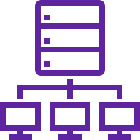
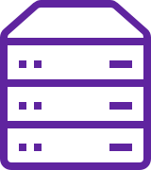
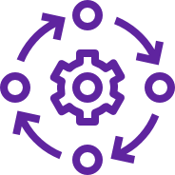
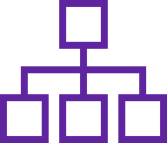
Cloud Adoption Journey – Enterprise Landscape
Technology Landscape Components
Legacy Enterprise Technology Landscape
On-Prem DC
Data Storage in Silos
Monolithic Apps
Desktop User Experience
BI Tool
Traditional Business Model
Organization Structure
Forced or Pro-active Transformation
Transformation Stages
Business Requirement and Insight | Analysis and Design | Core Architecture Build and iteration | Deploy | Operations & Governance
Define Business objectives,
Application Portfolio Assessment
Critical success factors
Finalize IT resource,
Cloud provider selection
Target Architecture,
Environment setup
Right sizing of Resource-Compute, Storage, Database and Network
Infrastructure as a code
Resource provisioning Template
Selection of Migration tool
Implement migration model
Provisioning of Compute, storage and network services
Cloud Service Management and its optimization
Comply, Control and Secure the cloud environment

Slide 57

Key Cloud Adoption Drivers
Global Scale
Digital User Experience
Worldwide reach, Hyperscale & Elasticity with economic benefits
Omni channel
experience on Mobile platforms & enabling user Mobility
Reliability & Resiliency
Compliance & Security
Reliable trading - High Availability, Dynamic Failover, COVID lessons learnt
Regularity Compliance, Data Protection & confidentially
IT Simplification
Driving Innovation
Accelerated Time to Market - DevOps, DevSecOps, Managed PaaS
SaaS leverage - Microservices, Analytics, AI, Blockchain and IoT enabling business workflows

Slide 58



Cloud Adoption Journey Road Map
Cloud Adoption Delivery Framework
Cloud Adoption Goals
Cloud Adoption Approach
Customers do business in a heterogeneous World so DXC Luxoft is committed to delivering the best customer experience across software, services, and support in their cloud adoption Journey
Empower enterprise mobility
Transform the datacenter
Enable application innovation
Unlock insights on any data
Support application lifecycle management
Define how to select and prioritize applications for migrations.
Understand proven best practices to migrate applications to cloud Platform
Get Exposure to variety of application migration patterns – ranging from cloud Server Migration/Data Migration, to App Code* for CI/CD.
Validate Landing Zone, Operations run book and Security playbook by actually testing applications in Cloud platform
Cloud Adoption Phases
Cloud Adoption Tools
Cloud Adoption Key Success
Planning and Discovery
Design and Build
Migrate
Operation
Governance
Discovery tools
Migration tools
Monitoring tools
DevOps Tools
Project Management Tools
Cost Optimization
Automation and Orchestration
Improve operation efficiency and performance
Reduce Risk
Increase agility

Slide 59

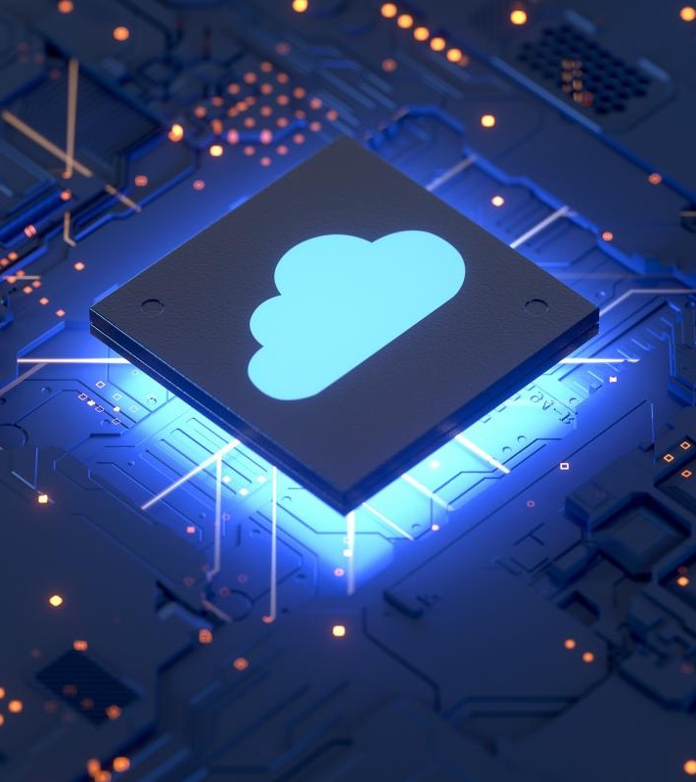
Cloud Adoption Framework (CAF)
The Cloud Adoption Framework brings together cloud adoption best practices. It provides a set of tools, guidance, and narratives that would help shape technology, infrastructure, and people strategies for driving your desired business outcomes during your cloud adoption effort.
The cloud adoption framework objectives includes:
The Cloud Adoption Framework provides tools and guidance for implementing cloud technologies to In-corporate business, people and process changes,
Cloud Adoption framework" is used to describe collections of development tools to middleware to database services that ease the creation, deployment and management of cloud applications
Aligns cloud adoption with business objectives across the cloud adoption stages.
CAF Standardize technology adoption to reduce technology debt and streamlines cloud services management.
CAF ensures security of infrastructure, applications, and data, while ensuring data sovereignty.
CAF drives audit readiness for infrastructure applications.
CAF allows periodical review of the reference architecture, approved list of services, security controls and cost optimization techniques.

Slide 60
Why do we need a Cloud Adoption Framework
To ensure that applications are good cloud citizens
Automated Governance
Grow Capability and expand Global Coverage
To identify the applications which are suitable for the cloud
Accelerate innovation
To work out a roadmap to get the apps to cloud
To identify existing pain points
Enhance Customer Experience
To identify resource upskilling and training requirement
Automated Governance
To define priority of app migration
To enable a smooth migration, when ready for execution
To ensure optimization of Resource usage to control IT spending
To facilitate quick deployment of applications for business agility

Slide 61
Evolution of Web
Explosive growth in applications:
biomedical informatics, space exploration, business analytics,
web 2.0 social networking: YouTube, Facebook
Extreme scale content generation: e-science and e-business data deluge
Extraordinary rate of digital content consumption: digital gluttony:
Apple iPhone, iPad, Amazon Kindle, Android, Windows Phone
Exponential growth in compute capabilities:
multi-core, storage, bandwidth, virtual machines (virtualization)
Very short cycle of obsolescence in technologies:
Windows 8, Ubuntu, Mac; Java versions; C → C#; Python
Newer architectures: web services, persistence models, distributed file systems/repositories (Google, Hadoop), multi-core, wireless and mobile
Diverse knowledge and skill levels of the workforce

Slide 62
In software engineering, SOA (service-oriented architecture) is an architectural style that focus on discrete services instead of a monolithic design.^{[1]} By consequence, it is as well applied in the field of software design where services are provided to the other components by application components, through a communication protocol over a network. A service is a discrete unit of functionality that can be accessed remotely and acted upon and updated independently, such as retrieving a credit card statement online. SOA is also intended to be independent of vendors, products and technologies.
A web service is any piece of software that makes itself available over the internet and uses a standardized XML messaging system

